Slide 1
Natural Language Processing with Transformers
Chapter 1: Hello Transformer

Slide 2
Introduction to Transformer Models
Introduced by Google researchers in 2017
Revolutionized NLP through their efficiency and scalability
Encoder-Decoder-Framework
Central mechanism: attention model, which considers context across the entire sequence
Transfer Learning

Slide 3
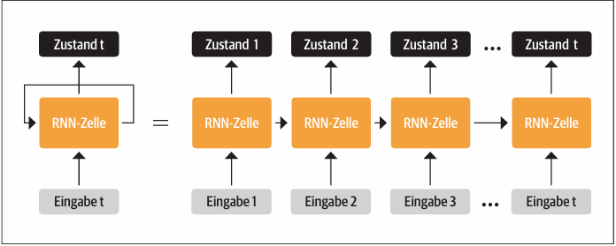
Encoder-Decoder-Framework
Recurrent Neural Networks(RNN) receives input
Processes input and outputs a hidden state vector
Feeds information back to itself for the next step through a feedback loop

Slide 4
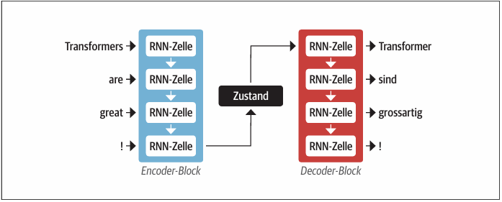
Encoder-Decoder-Framework
Hidden state can be a bottleneck, as it must represent the entire input sequence
This bottleneck can be prevented by allowing the decoder access to all hidden states of the encoder: Attention Mechanism

Slide 5
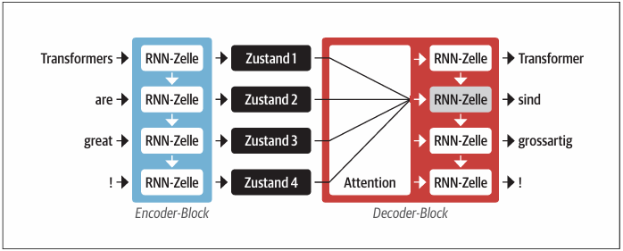
The Attention Mechanism
Attention allows the output of a hidden state at each step, which the decoder can access.
The decoder assigns different weights to each encoder state at each decoding step (prioritizing relevant states to manage large inputs)
This mechanism helps models learn non-trivial associations between words in translations by focusing on the most relevant input tokens at each step.

Slide 6
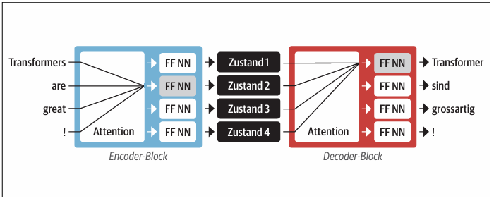
The Attention Mechanism
Recurrent attention models improved translations but had the drawback of sequential calculations, preventing parallelization.
Transformers introduced Self-Attention*, eliminating recursion and allowing attention across all states in the same layer.
Both the encoder and decoder in Transformers use Self-Attention mechanisms, leading to faster training

Slide 7
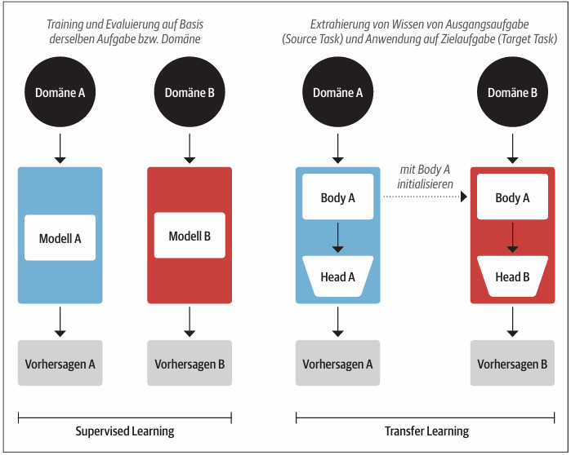
Transfer Learning
Convolutional Neural Networks (CNN) are often trained using transfer learning and then fine-tuned for new tasks.
The model is divided into a body (general feature extractor) and a head (task-specific network).
The body learns general features which are used to initialize a new model for the new task.

Slide 8
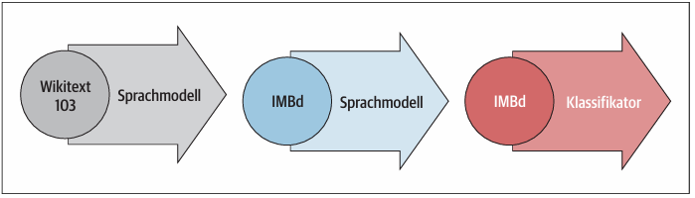
Transfer Learning
Introduced in 2017/18, ULMFiT (Universal Language Model Fine-tuning) is a framework for applying pre-trained LSTM (Long Short-Term Memory) models to various NLP tasks through fine-tuning.
Before Transfer Learning was only used for Computer Vision.

Slide 9
Transfer Learning
Pretraining:
Initial training predicts the next word based on previous words, known as language modeling, using unlabeled data like Wikipedia.
Domain Adaptation:
After pretraining on a large corpus, the model is transferred to a domain-specific corpus (e.g., from Wikipedia to IMDb reviews) for predicting the next word in the target corpus.
Fine-tuning:
The model is fine-tuned with an additional classification layer for the target task (e.g., sentiment analysis of movie reviews).

Slide 10

Introduction of Hugging Face
ULMFiT provided a practical framework for pretraining and applying transfer learning in NLP, aiding the breakthrough of Transformers. (GPT & BERT)
Initial models were released in incompatible frameworks. The Hugging Face Transformers library provided a unified API, accelerating research and facilitating integration into real-world applications.

Slide 11
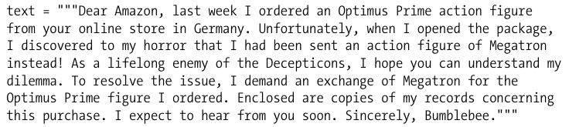
Overview of Transformer Applications
Every NLP task starts with a text, such as a fictional customer feedback example.
For customer feedback, determining if it's positive or negative is crucial—this is called sentiment analysis, a subset of text classification.
The next step involves using the Huggingface Transformers library to determine the sentiment of the text.

Slide 12

Text classification
The huggingface Transformers library has a layered API for interacting at different abstraction levels.
Pipelines abstract all steps to convert raw text into predictions using a fine-tuned model.
The text-classification pipeline is designed for sentiment analysis and supports multi-class and multi-label classification.
Predictions are made by passing a string or list of strings to the pipeline, returning a list of predictions as dictionaries.

Slide 13


Text classification
Using Pandas to display predictions as a DataFrame:
The model predicts the sentiment (e.g., NEGATIVE with a score of 0.901546), indicating the text likely conveys a negative sentiment, which is plausible for a customer complaint.

Slide 14

Named Entity Recognition
In NLP, real-world objects like products, places, and people are called Named Entities.
Extracting these objects from text is called Named Entity Recognition (NER).
To perform NER, load the appropriate pipeline and feed it the customer review.

Slide 15
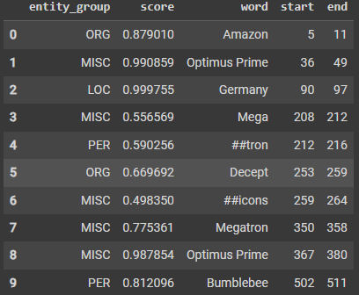
Named Entity Recognition
The pipeline recognized all entities and assigned categories such as ORG (Organization), LOC (Location), and PER (Person).
Used aggregation_strategy to group words based on model predictions; e.g., "Optimus Prime" (two words) is categorized as MISC (Miscellaneous).
Scores indicate the model's confidence in identifying entities.
The model was less confident with "Decepticons" and the first occurrence of "Megatron".
The hash symbols (#) in the word column are generated by the model's tokenizer, which breaks words into tokens.

Slide 16


Question Answering
In Question Answering, we provide the model with a context text and a question.
The model returns the text passage corresponding to the answer.
The pipeline also returns start and end indices, marking the answer span in the text.
This method is called extractive Question Answering, as the answer is directly extracted from the text.

Slide 17
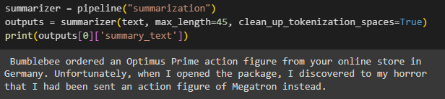
Summarization
Using the summarization pipeline, automatic summarization creates a concise version of a long text with all relevant facts.
This task is more complex as the model needs to generate coherent text.
But the model correctly identifies "Bumblebee" as the complaint's author.
Key arguments like max_length and clean_up_tokenization_spaces can be passed to the pipeline to further optimize results.

Slide 18
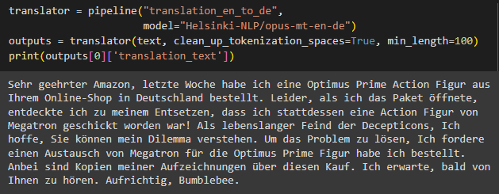
Translation
Machine translation generates text output, similar to summarization.
The model produces a good translation, correctly using formal pronouns like "Ihrem" and "Sie.“
Demonstrates how to replace the default model in the pipeline to select the most suitable model.

Slide 19
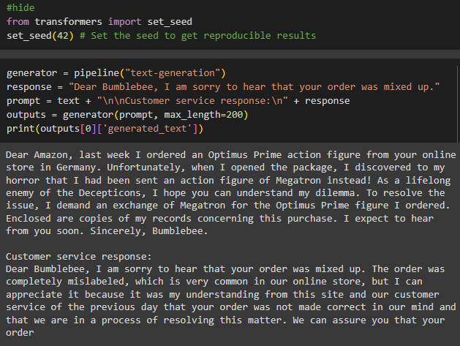
Text generation
The generated completion attempts to respond to customer feedback but may not effectively reassure "Bumblebee."
All models used in the example are freely available and pre-trained for their respective tasks.
Usually, models need fine-tuning for specific data; upcoming chapters will cover this process.

Slide 20
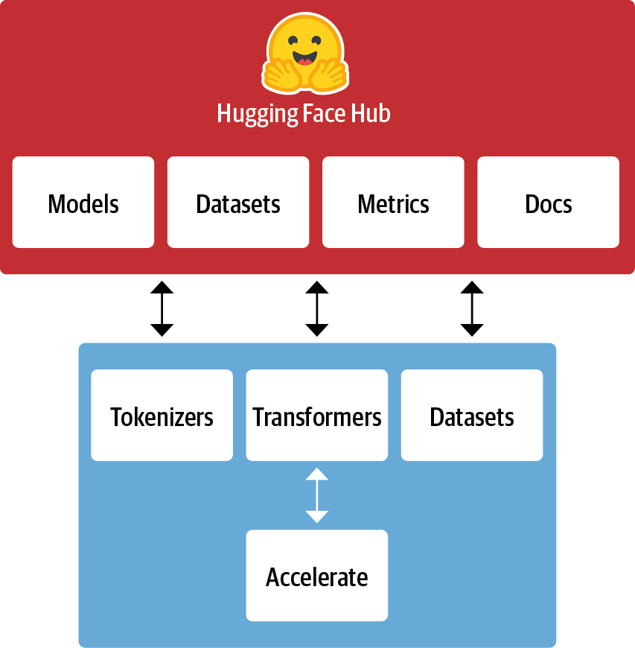
The Hugging Face ecosystem
The ecosystem comprises libraries and the Hub, primarily consisting of pretraining model weights, datasets, evaluation scripts, and more.
Libraries provide code, while the Hub offers resources for NLP and machine learning projects.

Slide 21
The Hugging Face Hub
Transfer Learning is crucial for the success of Transformer models, allowing reuse of pretrained models for new tasks.
Quick loading and experimenting with pretrained models is essential.
The Hugging Face Hub offers over 20,000 freely available models.
Filters for tasks, frameworks, and datasets help navigate the Hub and find promising models quickly.
Loading a model is as simple as one line of code, facilitating experimentation with various models.

Slide 22
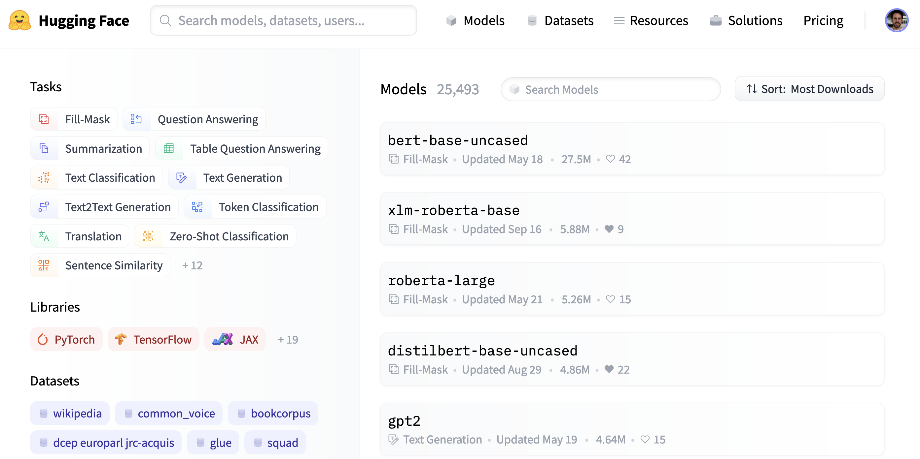
The Hugging Face Hub

Slide 23
The Hugging Face Hub
The Hub includes not only model weights but also datasets and evaluation metric scripts.
These resources help reproduce published results or use additional data for your application.
The Hub provides Model Cards and Dataset Cards documenting general aspects of models and datasets for informed decision-making.
A key feature is the ability to try out any model directly through various task-specific interactive widgets.

Slide 24
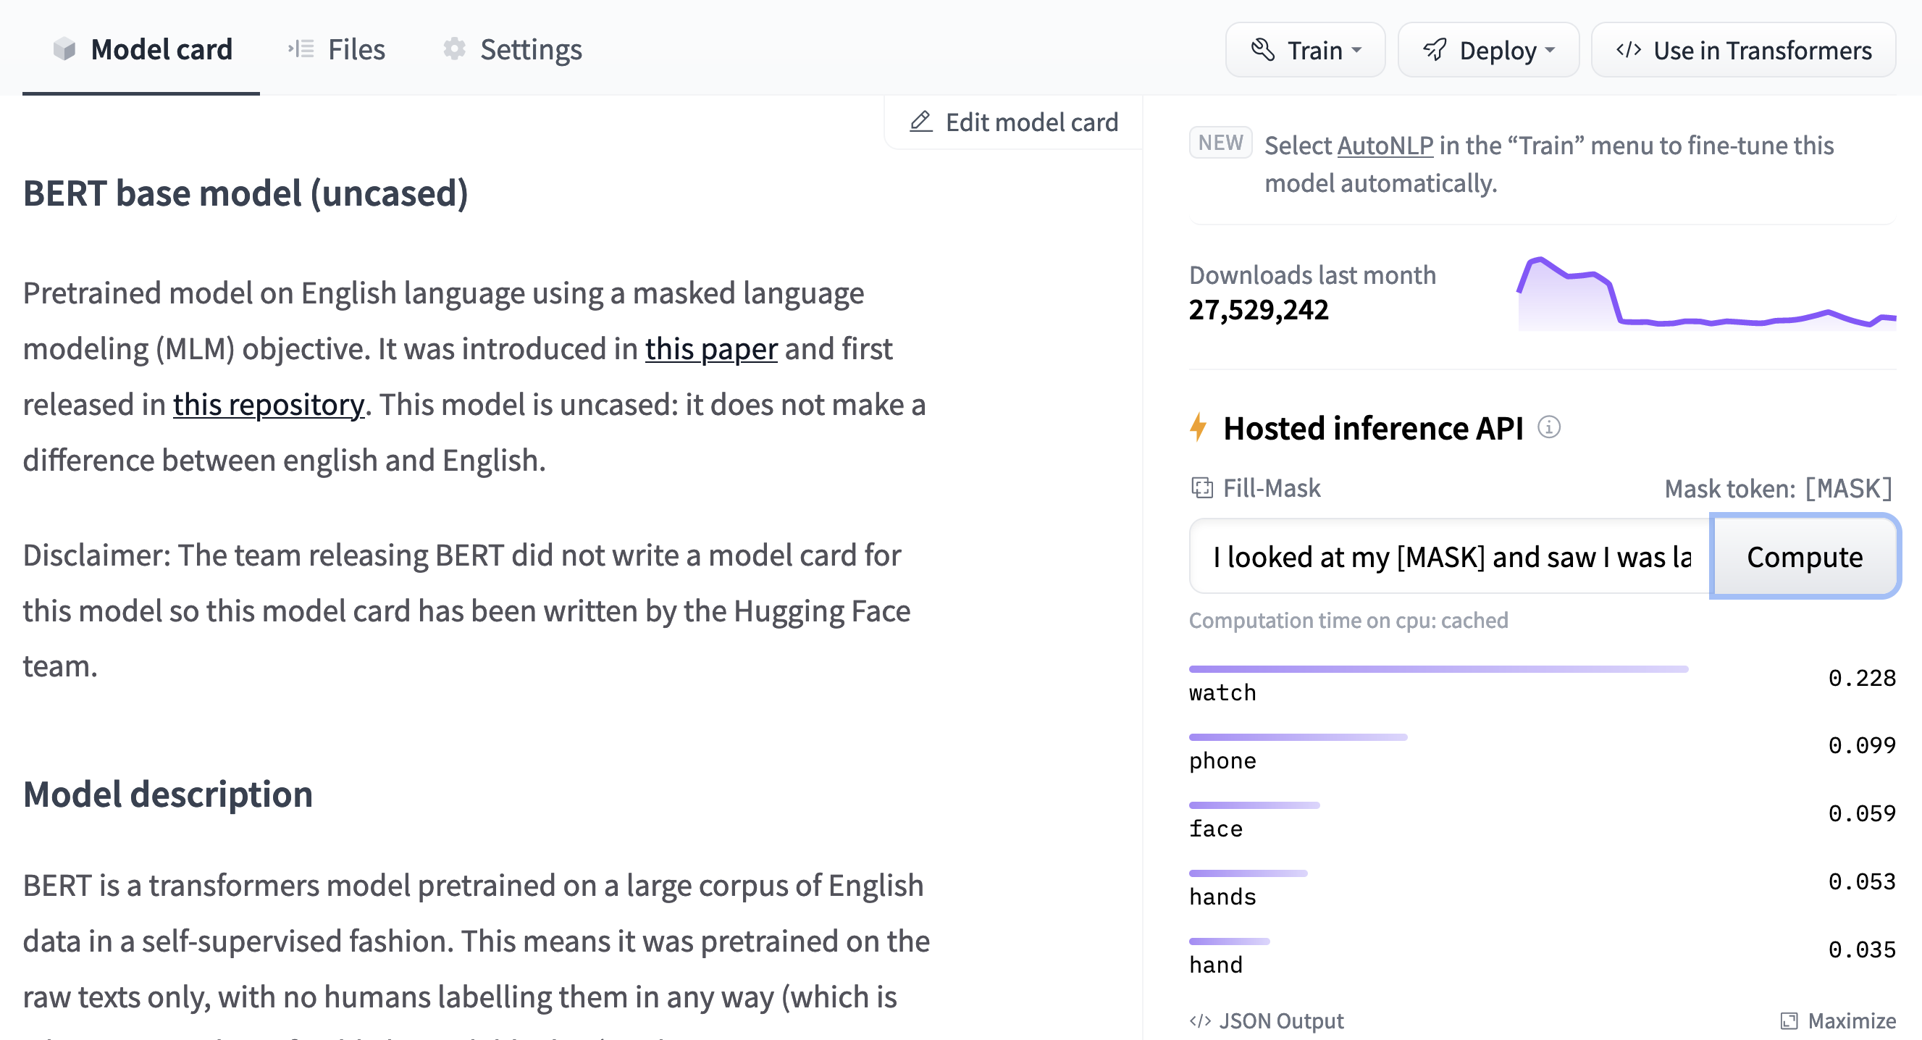
The Hugging Face Hub

Slide 25
Tokenizers library by Hugging Face
Tokenization breaks raw text into smaller units called tokens (words, word parts, or punctuation).
Transformers are trained using numerical representations of these tokens.
The Hugging Face Tokenizers library offers various tokenization strategies and is extremely fast due to its Rust backend.
It handles pre/post-processing, including input normalization and output conversion.
Tokenizers can be loaded similarly to pretrained model weights in the Hugging Face Transformers library.

Slide 26
Hugging Face's datasets library
Loading, processing, and storing large datasets can be challenging, especially when they exceed memory capacity.
The Hugging Face Datasets library simplifies this by providing a standard interface for thousands of datasets on the Hub.
It is compatible with popular frameworks like Pandas and NumPy.
Together with Hugging Face Transformers and Tokenizers, the Datasets library equips you to train your own Transformer models.

Slide 27
The biggest challenges with Transformer
Language: NLP research is mostly in English. Few resources exist for less common languages. Chapter 4 covers multilingual models and cross-lingual transfer.
Data availability: Transfer learning reduces labeled data needs but still requires significant amounts compared to humans. Chapter 9 addresses handling limited or no labeled data.
Working with long texts: Self-attention works well for short texts but is computationally intensive for longer documents. Solutions are in Chapter 11.
Opacity: Like other deep learning models, Transformers are mostly opaque, making it hard to understand their predictions. Chapters 2 and 4 explore methods to analyze prediction errors.
Bias: Pretrained on internet data, Transformers can inherit biases. Ensuring models are not racially, sexually, or otherwise biased is challenging. Chapter 10 delves into these issues.

Slide 28

Tokenizers
The hugging face NLP course introduces 3 different types of tokenizers:
Word-based
Character-based
Subword tokenization

Slide 29
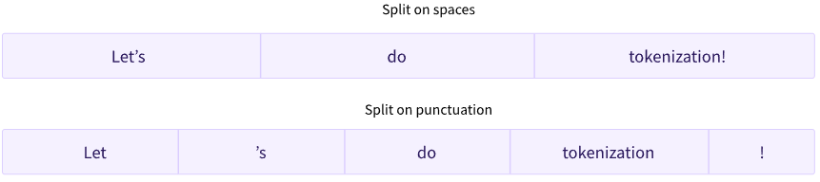
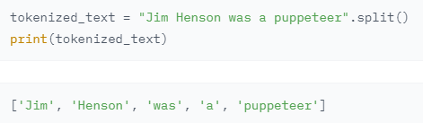
Word-based
Each word is assigned an ID starting from 0, up to the vocabulary size.
A word-based tokenizer needs an ID for every word in the language, leading to a huge number of tokens (e.g., 500,000+ words in English).
Words like "dog" and "dogs" are treated as unrelated by the model initially.
An "unknown" token (e.g., [UNK]) is used for words not in the vocabulary.
Frequent unknown tokens indicate poor tokenizer performance and information loss.
To reduce unknown tokens, a character-based tokenizer can be used.

Slide 30
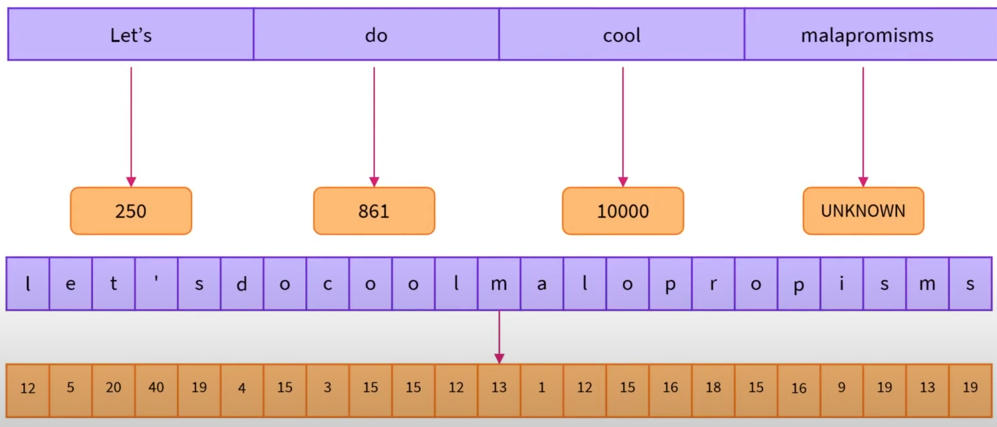
Character-based
Character-based tokenizers split the text into characters, rather than words. This has two primary benefits:vocabulary is much smaller & fewer unknown tokens, since every word can be built from characters.
Character-based tokenization is less meaningful as individual characters carry less information than words, but may vary by language (e.g., Chinese characters carry more information than Latin characters).
Character-based tokenization increases the number of tokens significantly (a single word may become 10+ tokens).

Slide 31
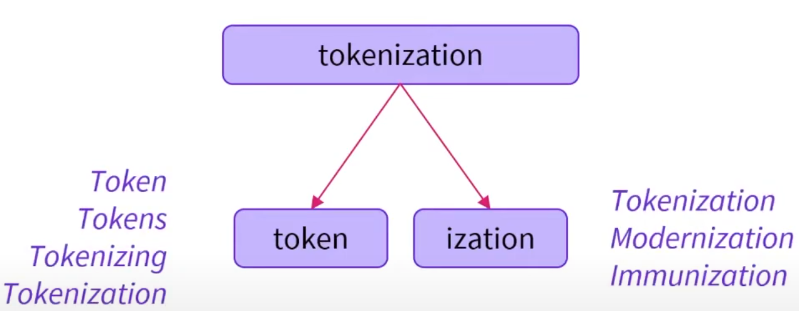
Subword tokenization
Subword tokenization splits rare words into meaningful subwords while keeping frequent words intact.
Example: “tokenization" splits into “token" and “ization".
This retains semantic meaning and is space-efficient.
There are many techniques: Byte-level BPE (GPT-2), WordPiece (BERT), SentencePiece/Unigram (multilingual models).

Slide 32
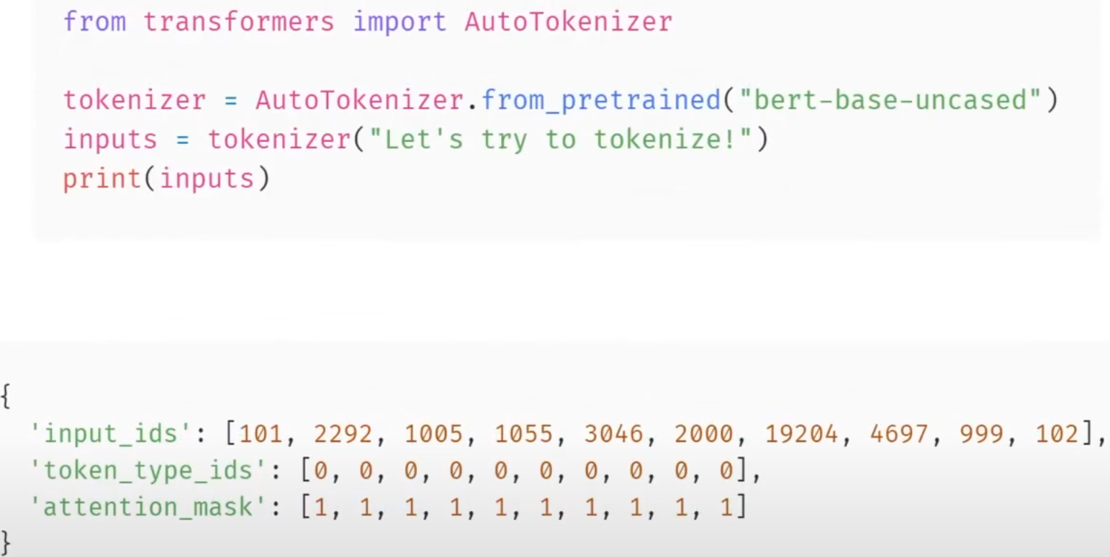
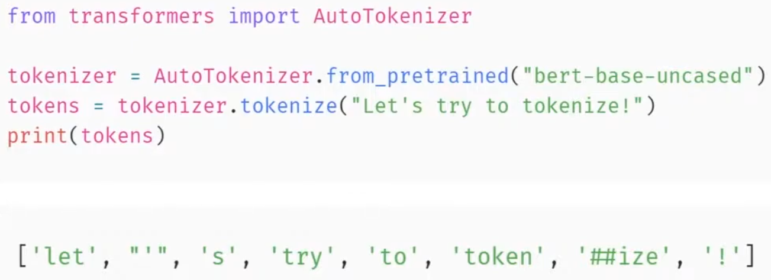
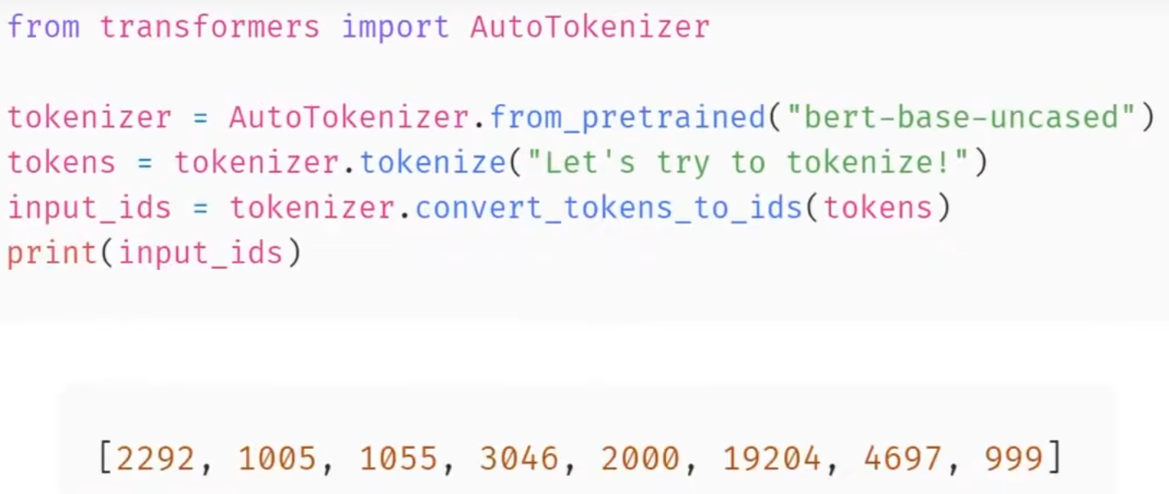
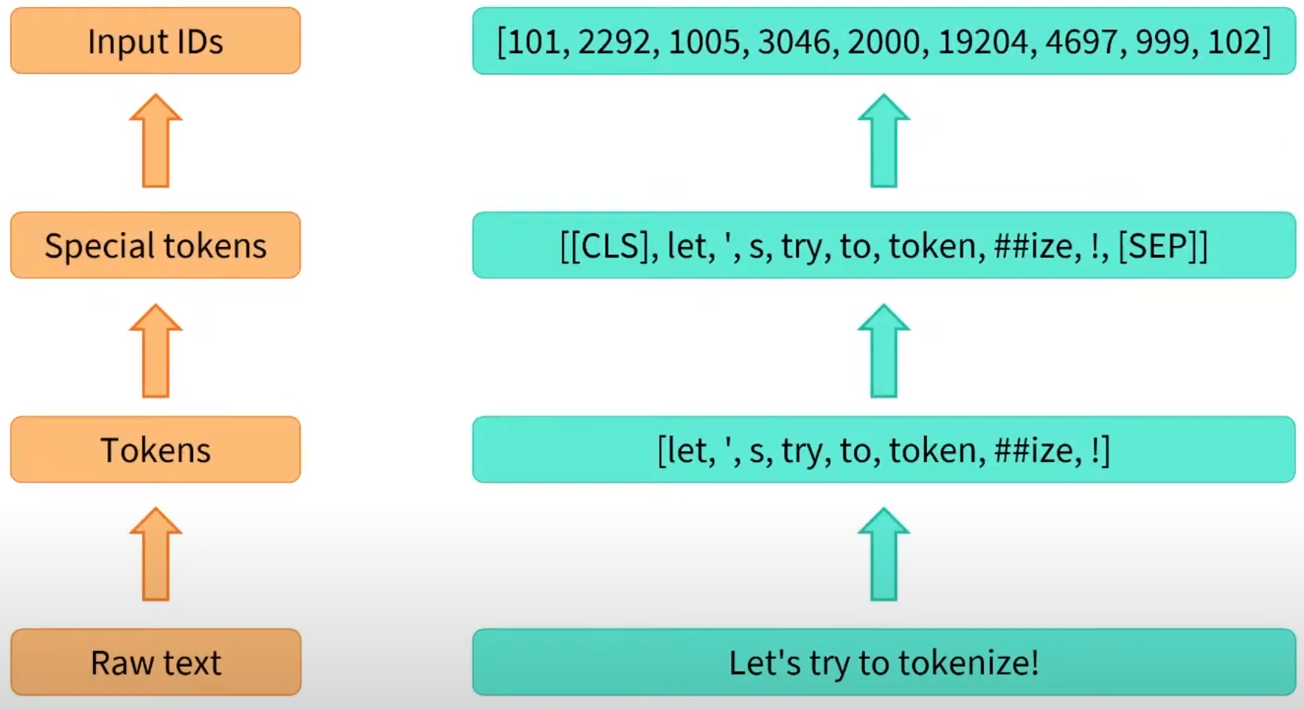
Using tokenizers

Slide 33
Sources
Natural Language Processing with Transformers Lewis Tunstall, Leandro von Werra, Thomas Wolf
https://huggingface.co/learn/nlp-course/chapter2/4?fw=pt

